Slide 1
RANDOM ALLOCATION
PREPARED BY : Abhilash Malhotra,
Metropolitan Magistrate /
nodal officer (computers)

Slide 2
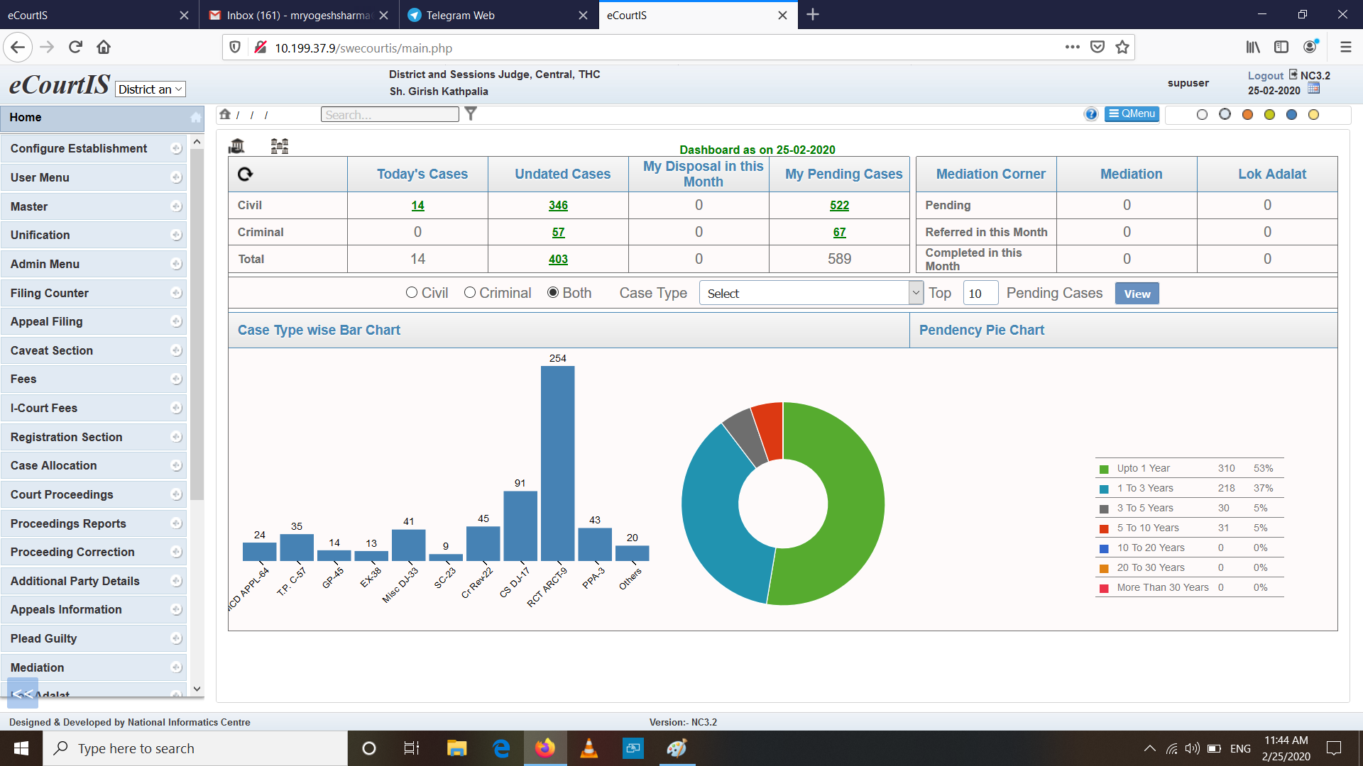
DASHBOARD OF NATIONAL CORE – CASE INFORMATION SYSTEM 3.2

Slide 3
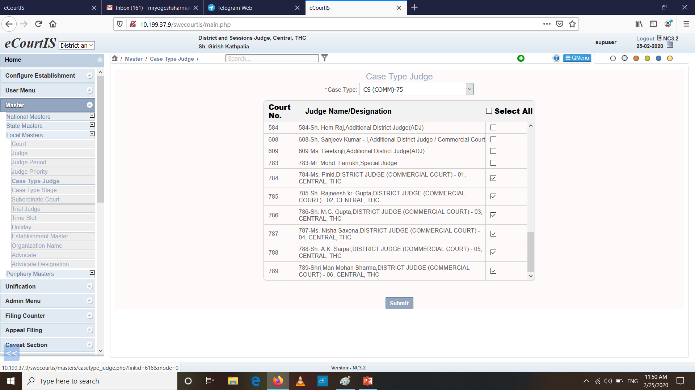
CASE TYPE JUDGE MAPPING IN LOCAL MASTER

Slide 4
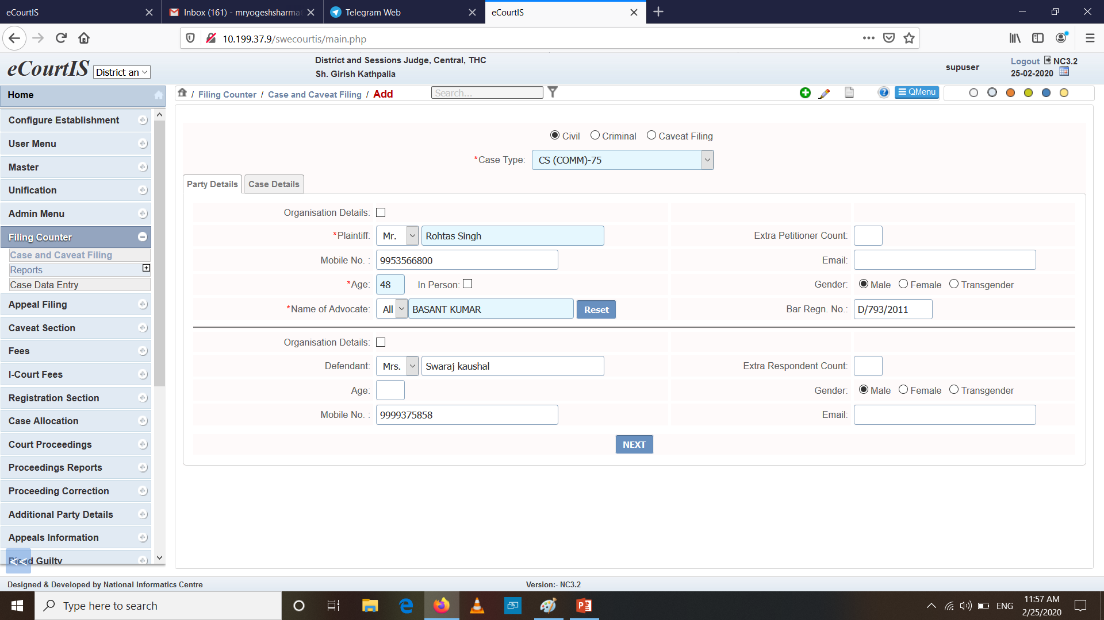
FILING OF A COMMERCIAL SUIT IN NC - CIS 3.2

Slide 5
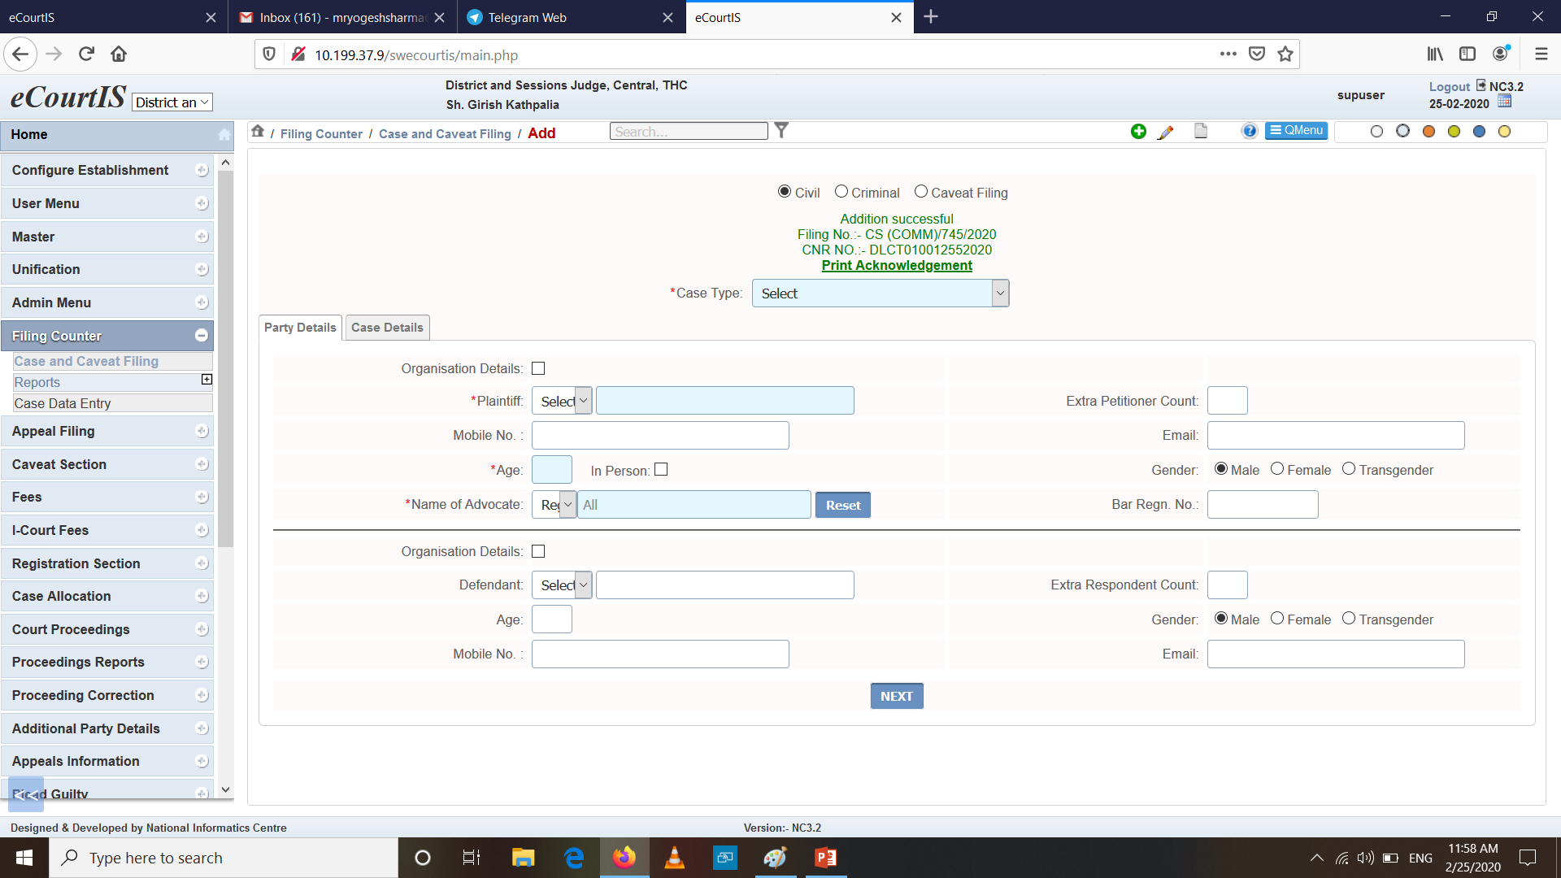
GENERATION OF FILING NUMBER AND CNR NUMBER OF A COMMERCIAL SUIT

Slide 6
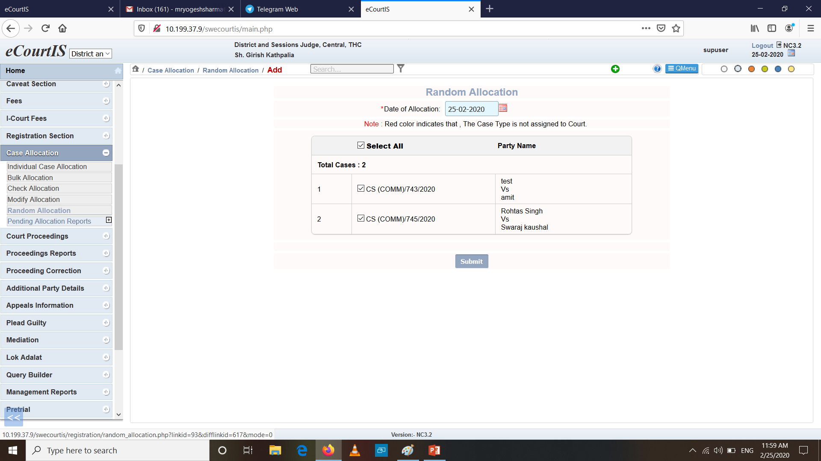
CASES AVAILABLE FOR RANDOM ALLOCATION

Slide 7
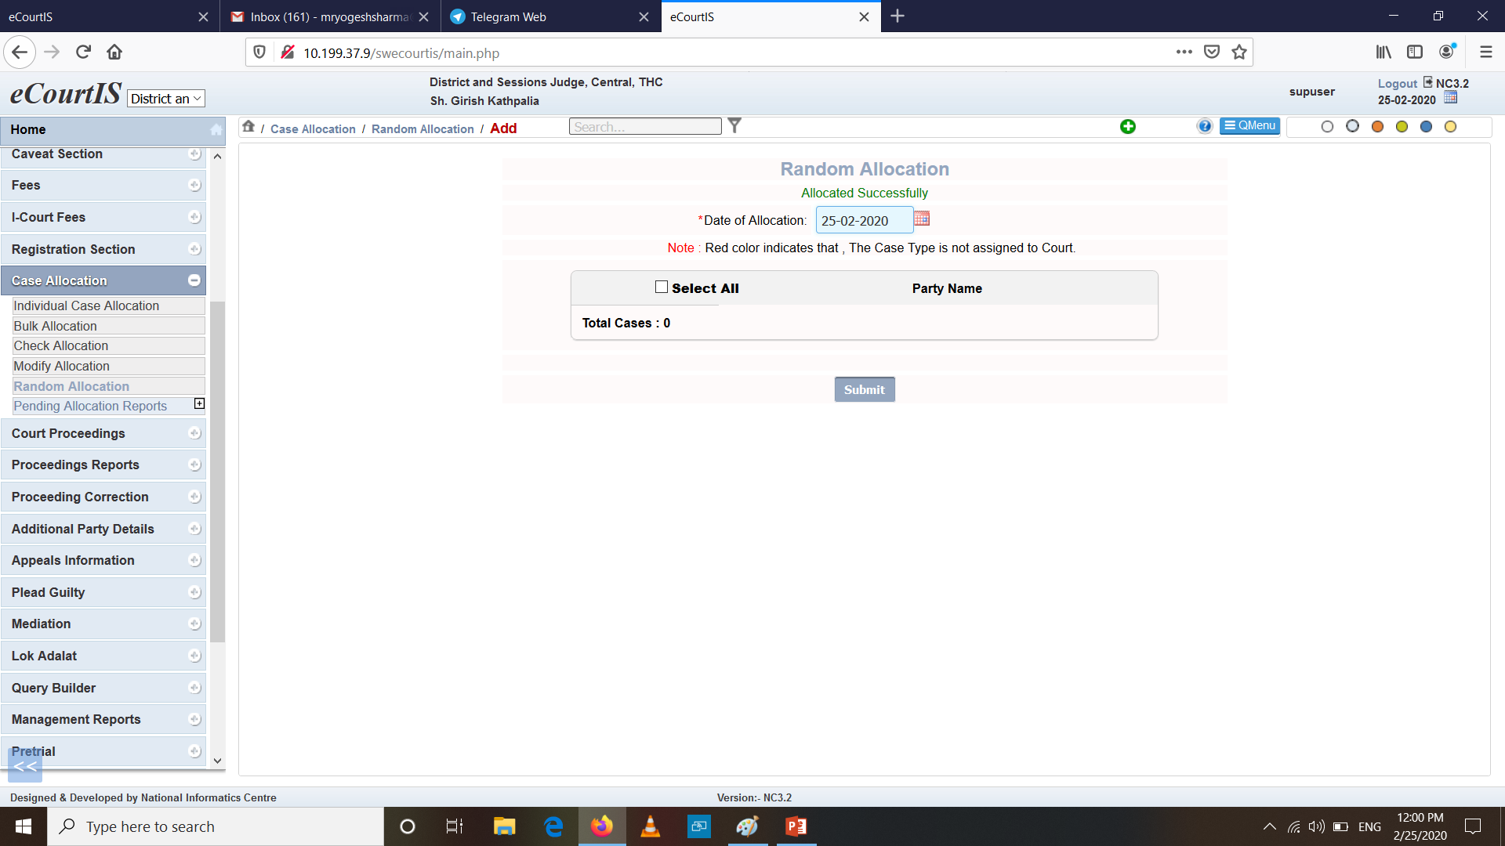
RANDOM ALLOCATION SUCCESSFUL PAGE

Slide 8
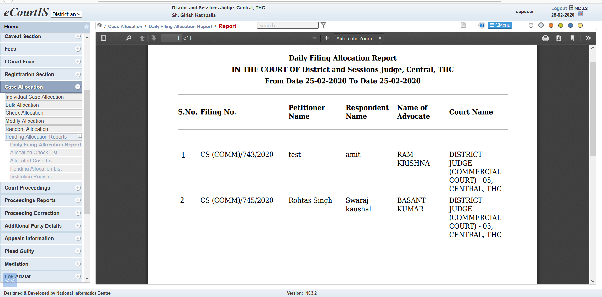
DAILY FILING ALLOCATION REPORT

Slide 9
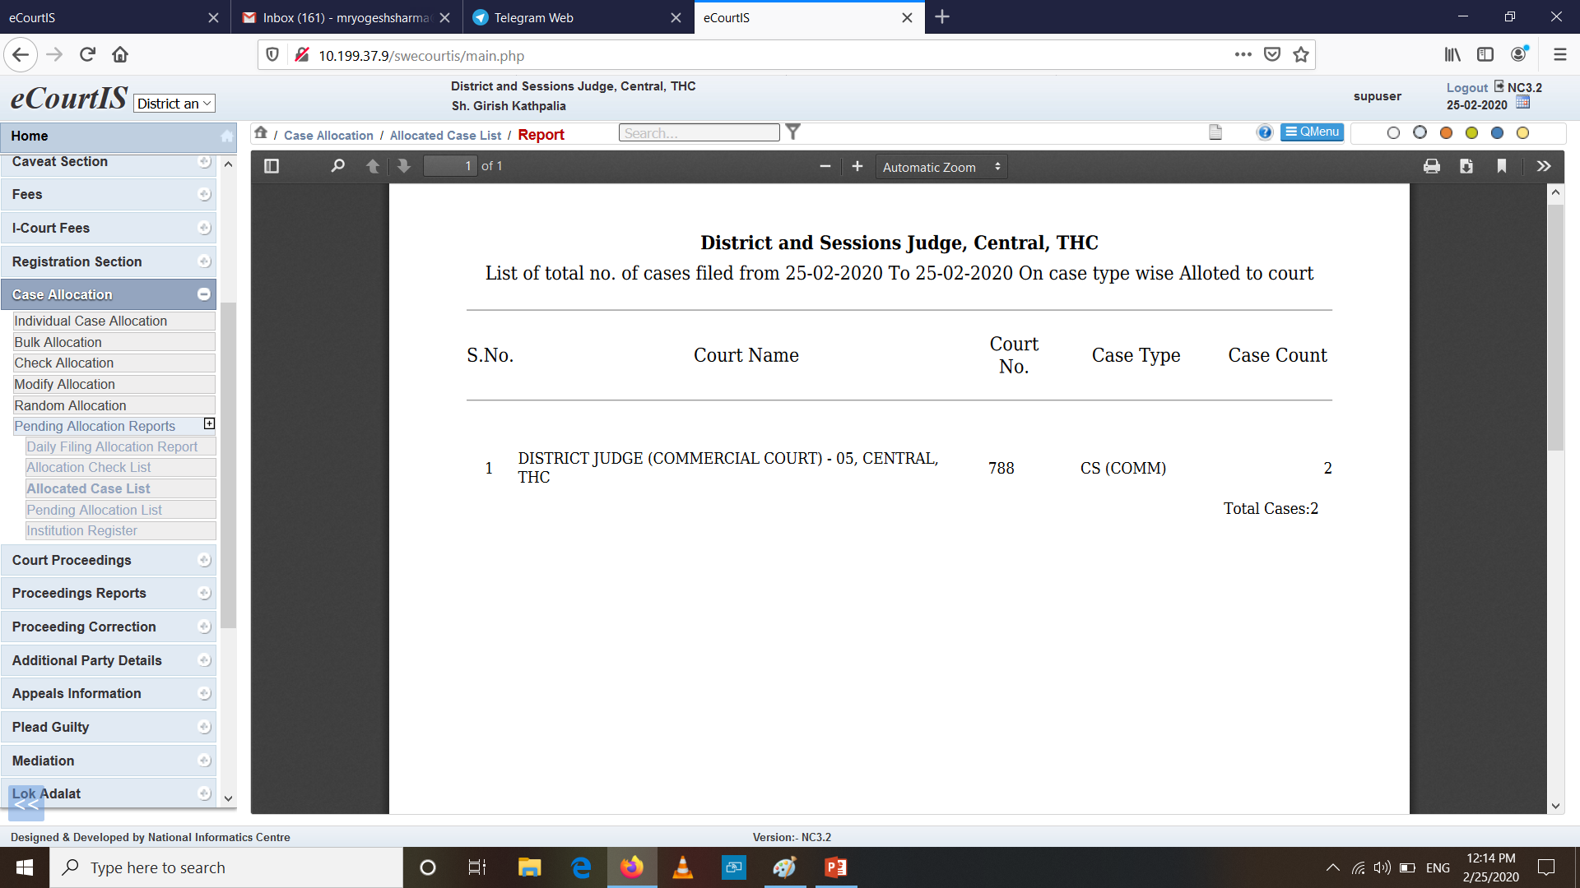
CASE TYPE WISE RANDOMLY ALLOCATED CASE COUNT REPORT

Slide 10
THANK YOU

